Slide 1

SMART WATER RESERVOIR MANAGEMENT SYSTEM USING TIME SERIES ANALYSIS
Department of CSE
GROUP-15
Siddharth Deshwal
Karan Sharma
Vallabh Mishra
Siddhartha Anand
PROJECT GUIDE
MS.UPASANA
ASST. PROFESSOR

Slide 2
Problem Statement
India faces a severe water crisis, affecting 600 million people with high to extreme water stress.
The country ranks 120th out of 122 in the water quality index, with 70% of water contaminated.
Groundwater, supplying 40% of India's drinking water, is rapidly depleting.
21 major Indian cities were predicted to run out of groundwater by this year.

Slide 3
Objectives
Phase 1 focuses on predicting water consumption using Machine Learning algorithms.
This prediction will help forecast water scarcity in various areas.
Data analysis will identify areas with higher water consumption for informed decision-making.
The model will provide statistics on water usage by different sectors and predict future consumption.
The main variable is the quantity of water in gallons, and the forecast will predict monthly water consumption levels.

Slide 4
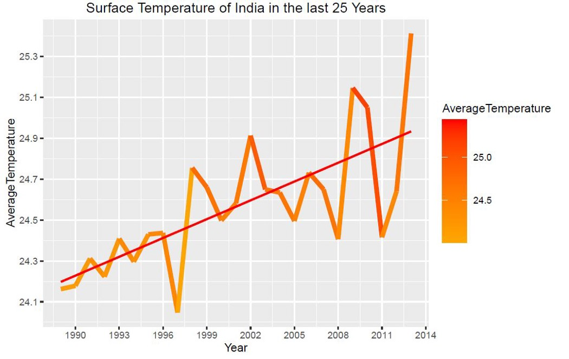
Continued..
India's average temperature is constantly increasing, due to which water reservoirs are constantly drying up.

Slide 5
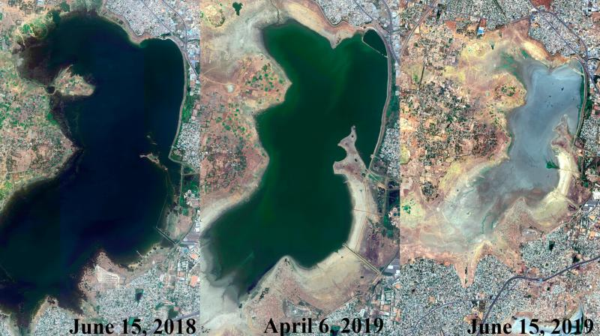
Case Study : Chennai
• Chennai's largest water reservoir Red Hill Water Reservoir is continuously drying up due to which there is going to be a huge water shortage in the in Chennai.

Slide 6
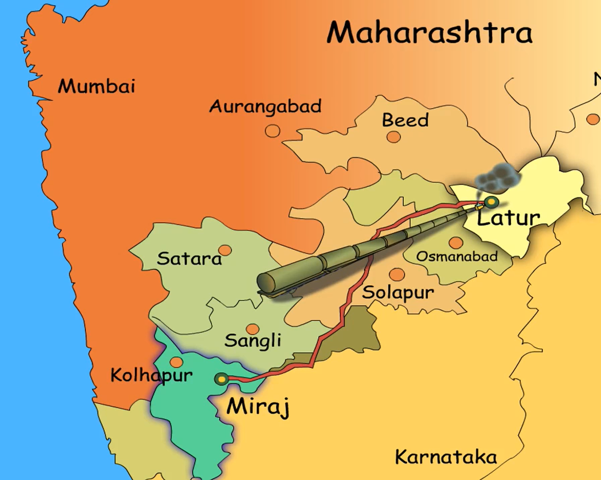
Case Study: Latur
There was not a single drop of water in 3100 villages out of the total 8522 villages of Marathawada in Maharashtra. To meet the shortage of water in Latur, 500000 liters of water was being sent to Latur every third day from Miraj place, located 342 km from Latur.

Slide 7
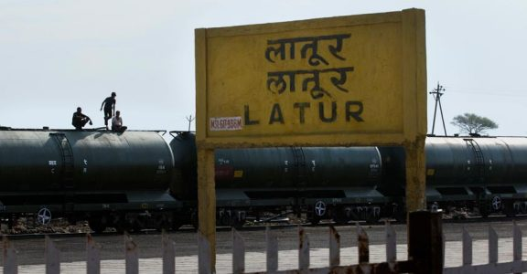
Continued..
To meet the shortage of water in Latur, water was being transported from various parts of Maharashtra and India by tank train to Latur.

Slide 8
Feasibility Study
Technical Feasibility
Operational Feasibility
Financial Feasibility
Environmental Feasibility

Slide 9
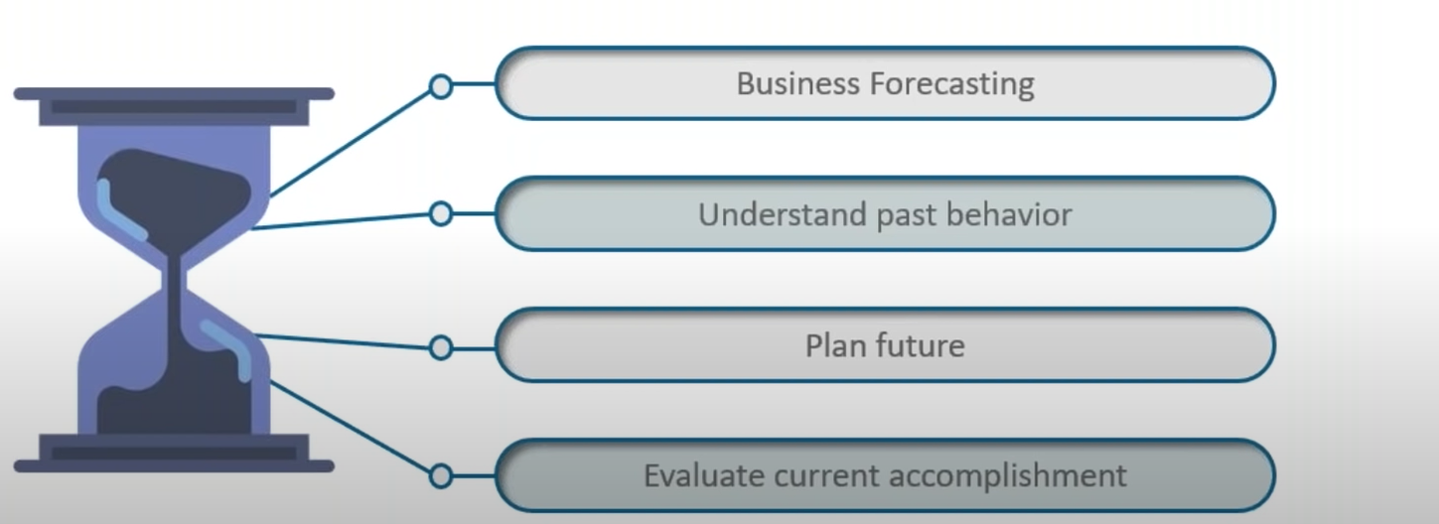
Time Series Analysis
Time series is a set of observation taken at specified times usually at equal intervals. On x-axis we have a time the y-axis the magnitude of the data. For this project we are taking date on x-axis and quantity of water (total gallons) in y-axis.

Slide 10
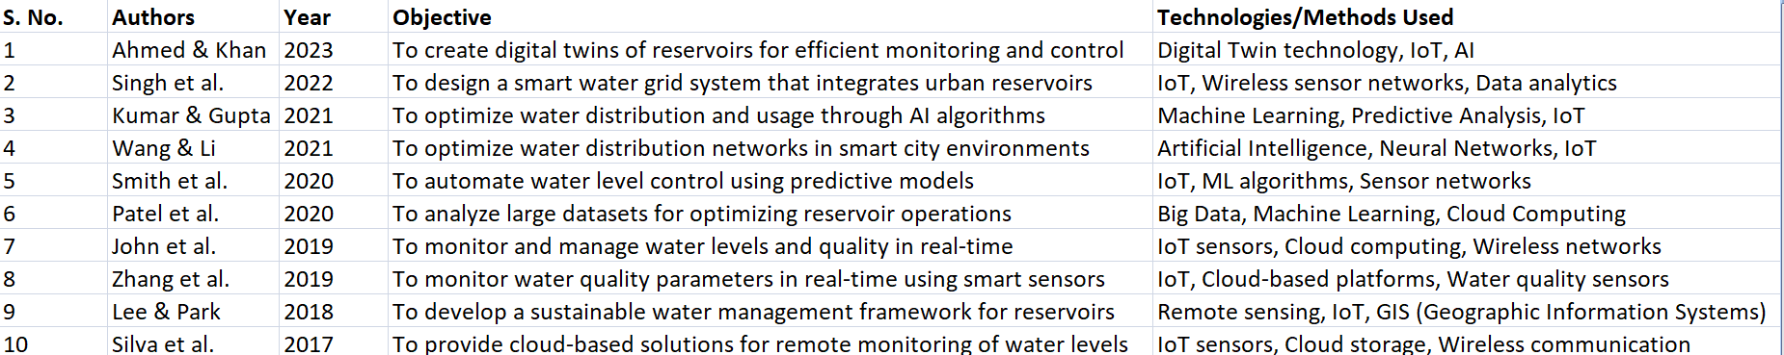
Literature Survey

Slide 11
Future Scope
Integration with IOT Technologies
Water Quality Monitoring And Public health Integration
Artificial Intelligence and Machine learning for Predictive Analysis
Predicting water level
Detecting Leaks
Optimizing Water Release

Slide 12
THANKYOU

